Slide 1
Sequence Analysis for server and client
Phase 2: Evaluation of Team 6

Slide 2
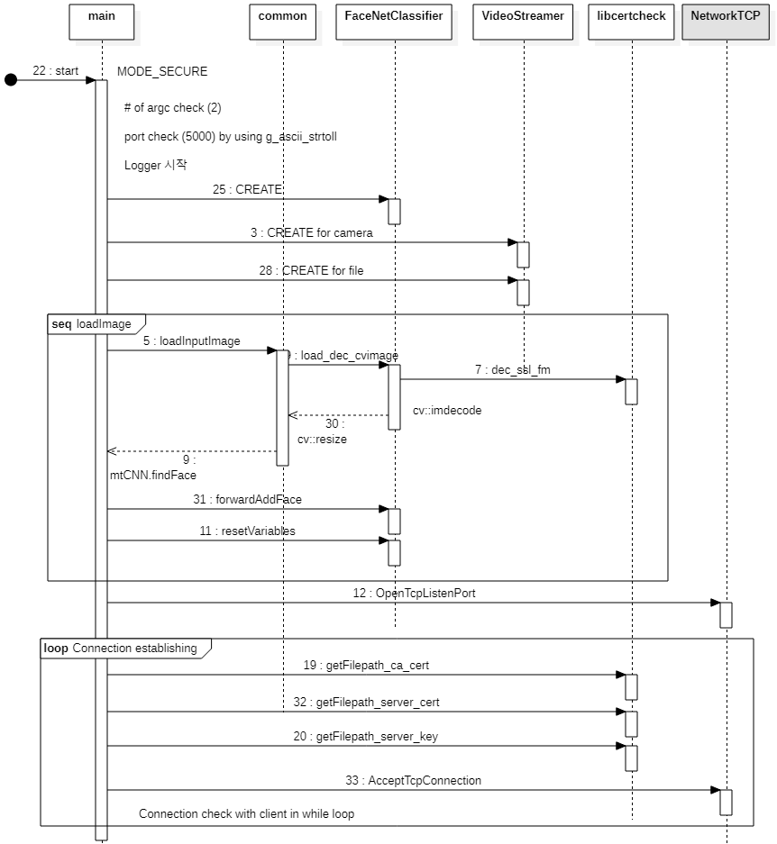
Server Initialization
Allow only one port (5000)
Load face images with decryption
Listening TCP Port

Slide 3
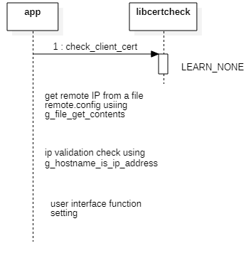
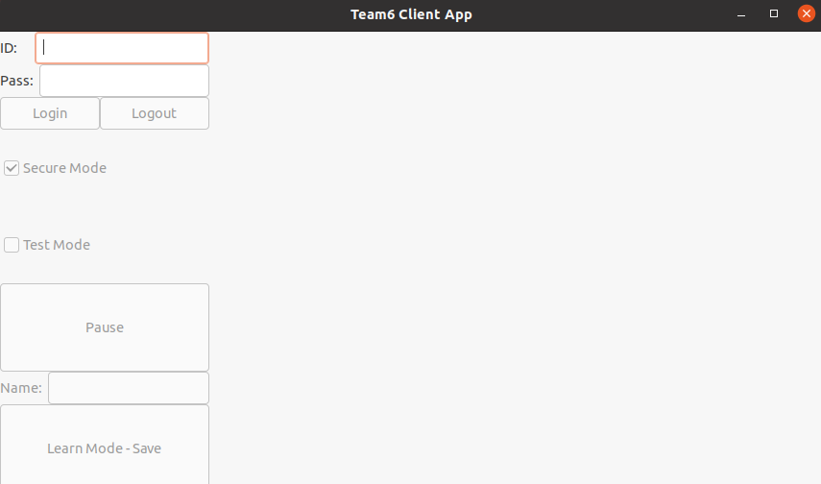
Client Initialization
get server IP address from config file as plain text
IP validation

Slide 4
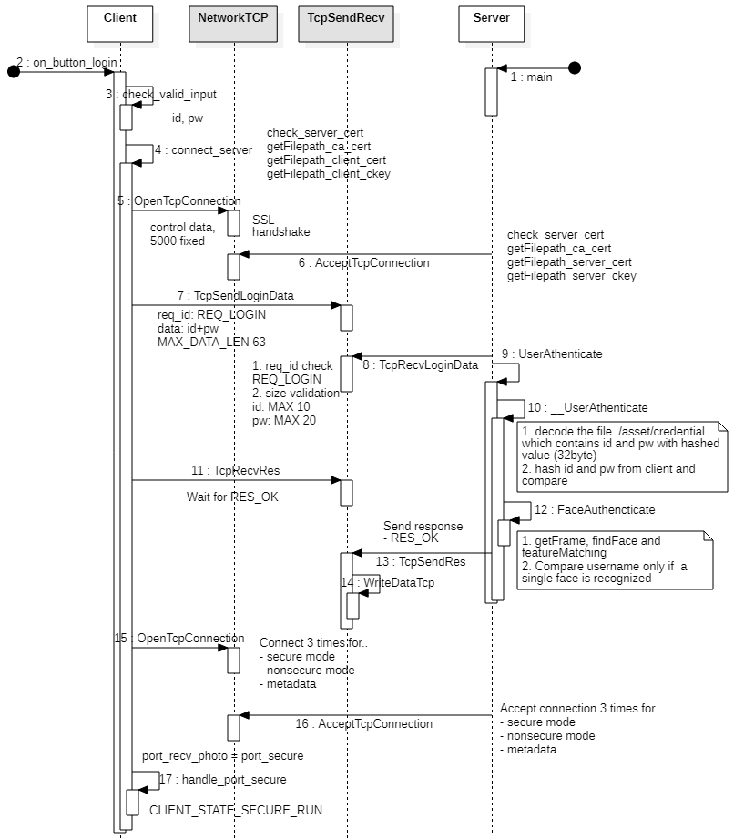
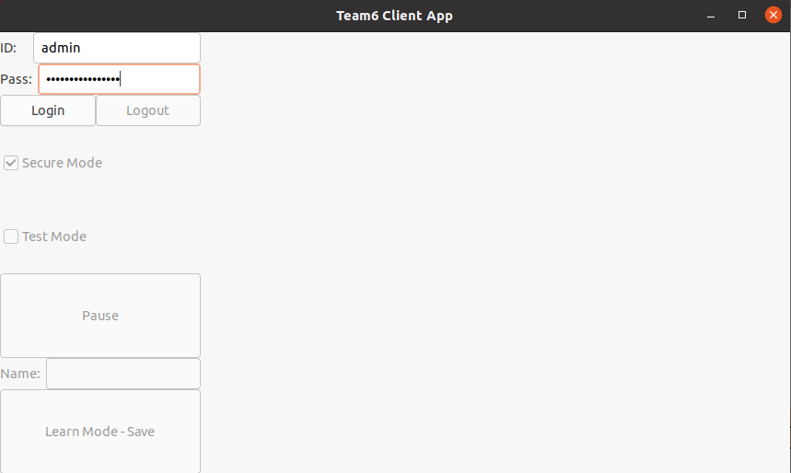
LogIn
Client
Input validation for ID/Pass
Establishing connection using certification
Server
Authentication of ID/Pass with credential file
Authentication of Face with ID
Image is not sent to client

Slide 5
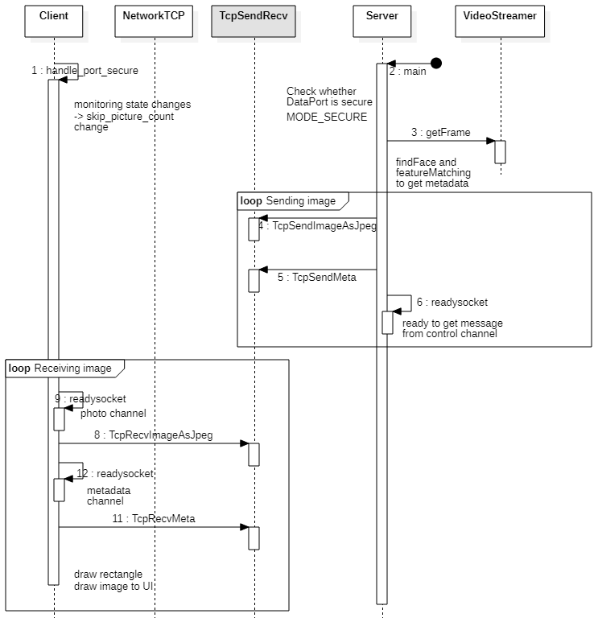
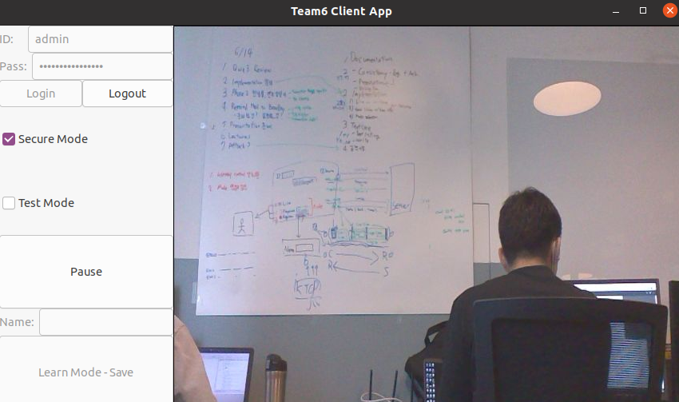
Data Communication
Data send/receive twice via each channel
Photo (image)
Metadata (face information)
Then, get a message from control channel if exists

Slide 6
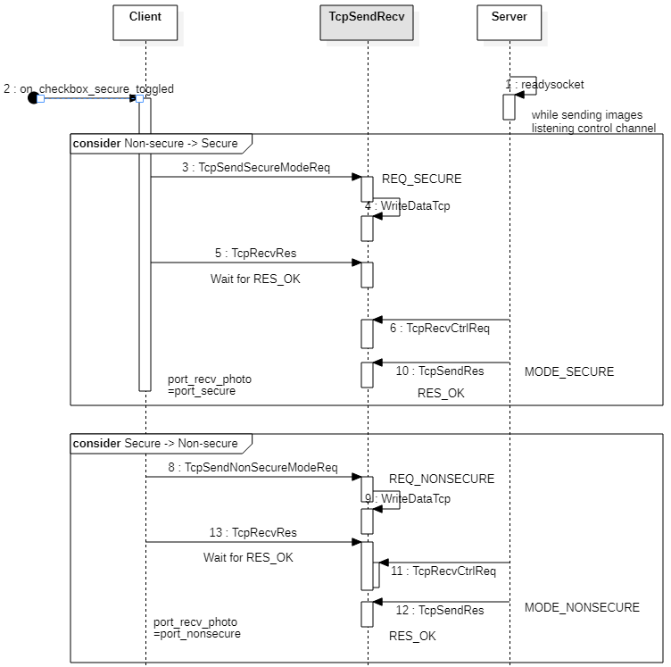
Secure mode Change
Secure ↔ Insecure
Client
Send Request via control channel
Wait for OK response then change port
Server
Just change mode status

Slide 7
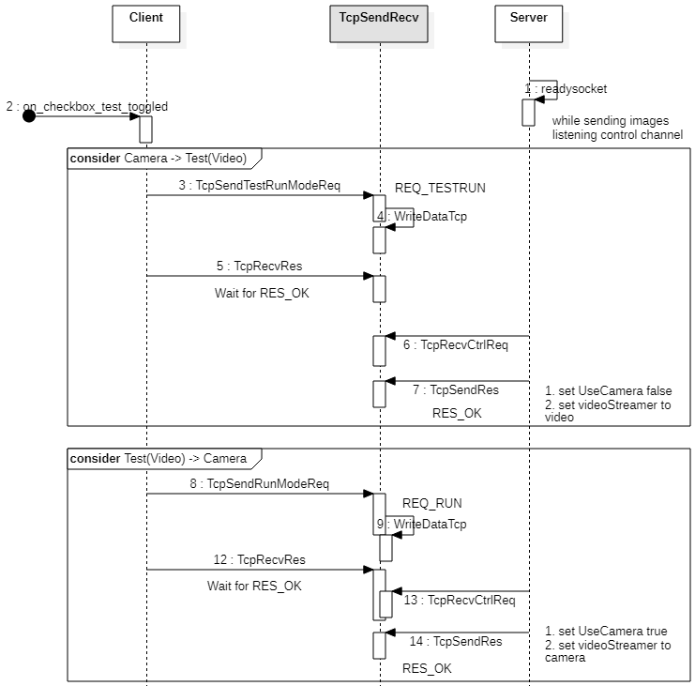
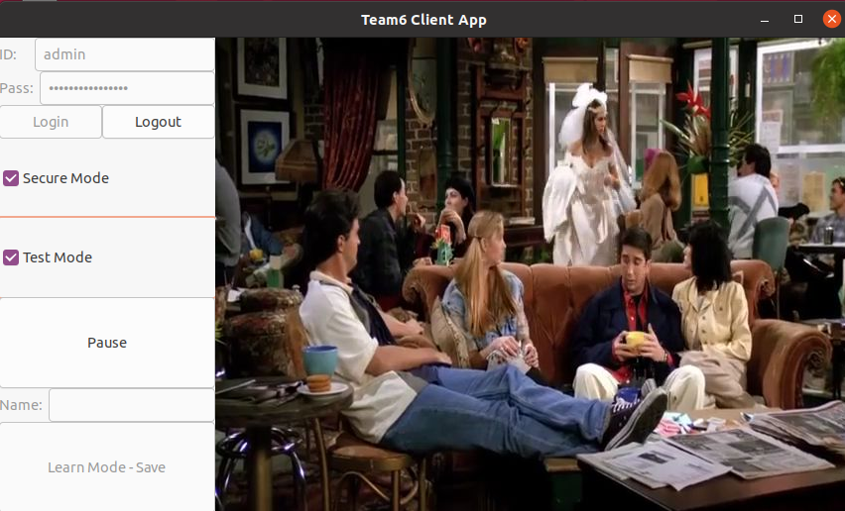
Play mode Change
Camera ↔ Test(Video)
Client
Send Request via control channel
Server
Change video source

Slide 8
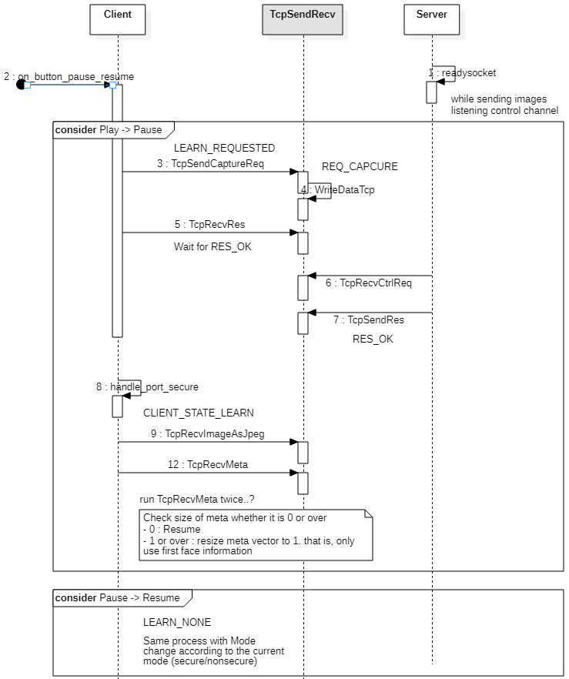
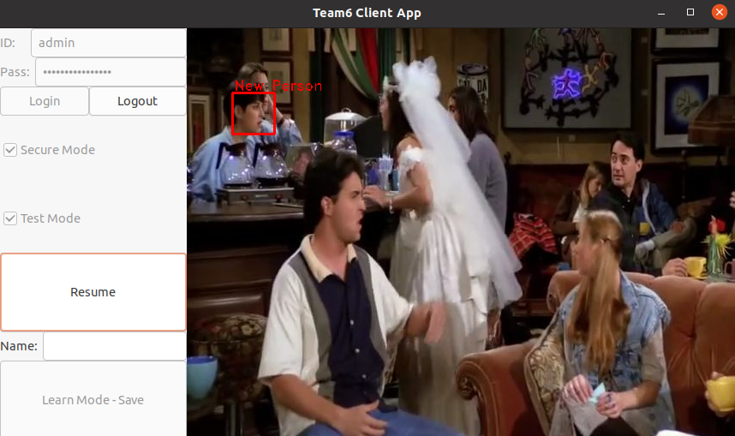
Pause - Switch to Learn mode
Check metadata
No face - Notification to try again.
1 or more faces - The first detected face can be the candidate to save
Possible no matter what the face is already registered

Slide 9
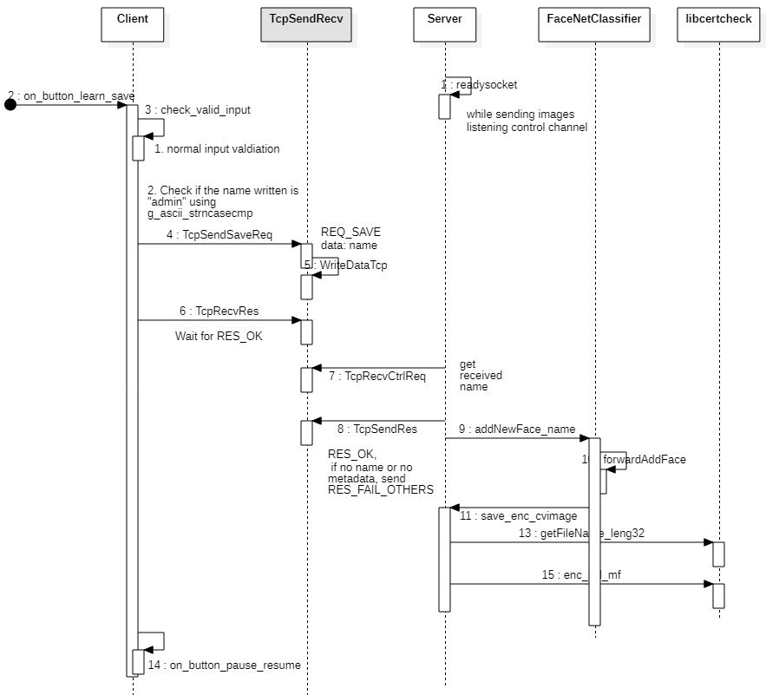
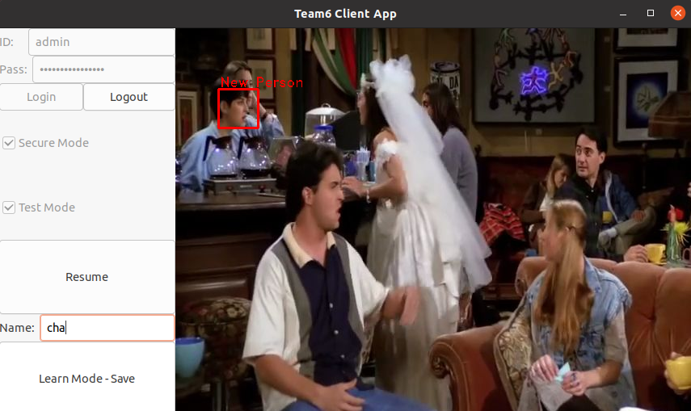
Save on Learn mode
Press save button with name
Client
Input validation for the name, send it
Admin is not allowed
Server
Save image with encryption

